Slide 1

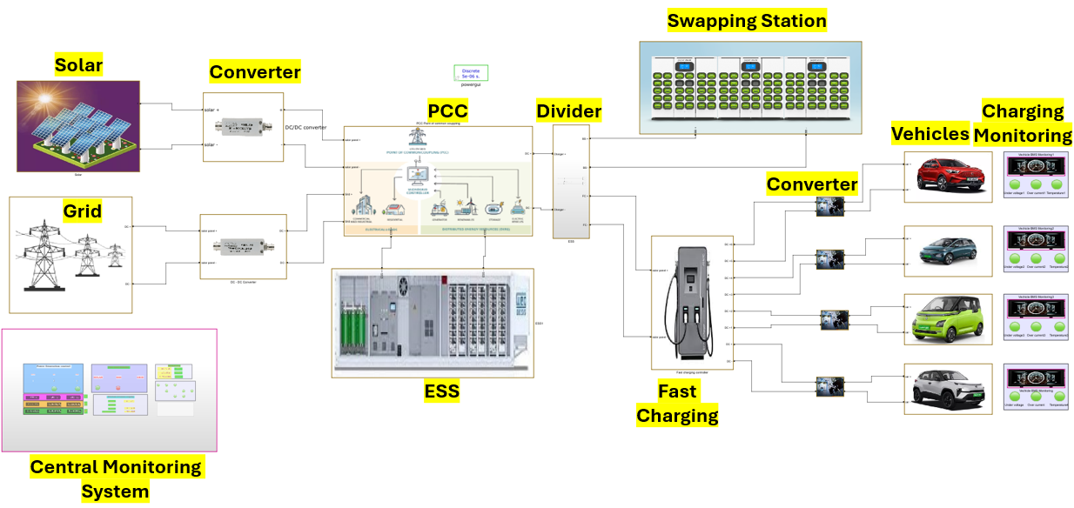
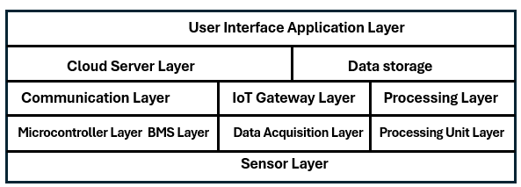
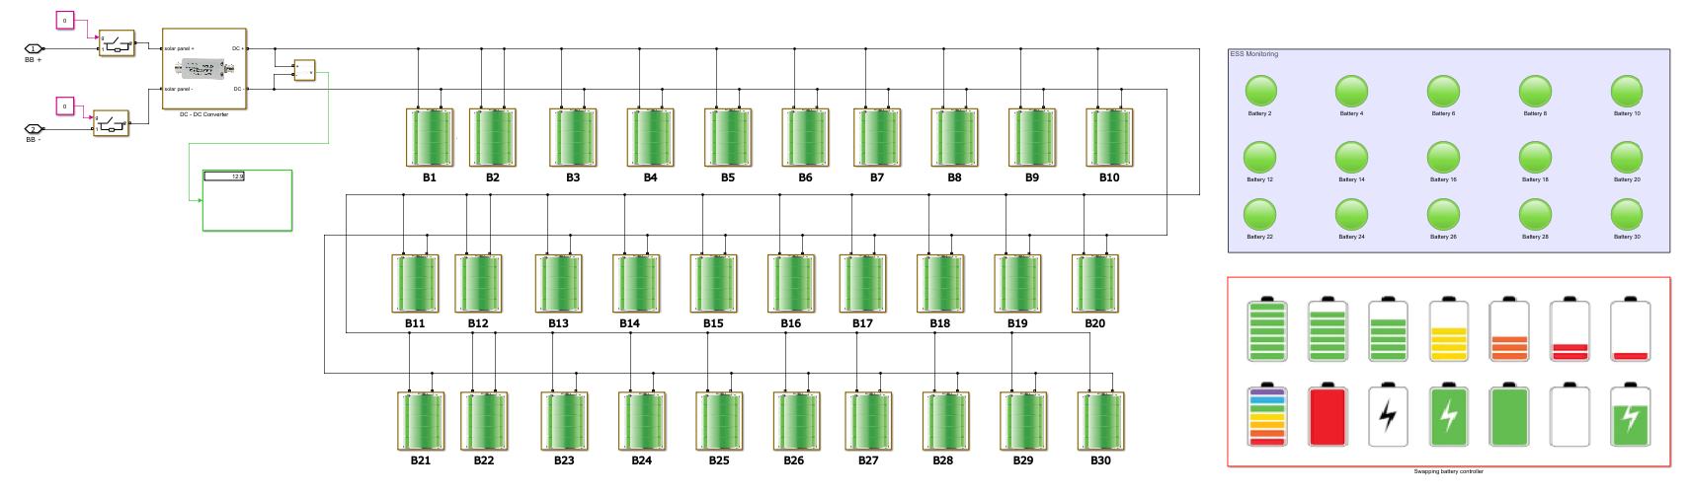
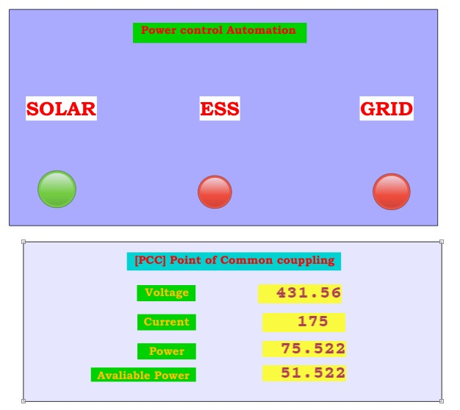
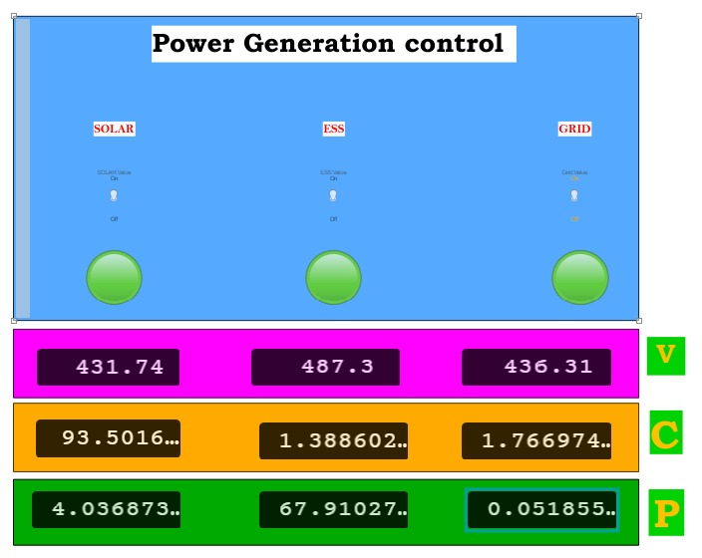
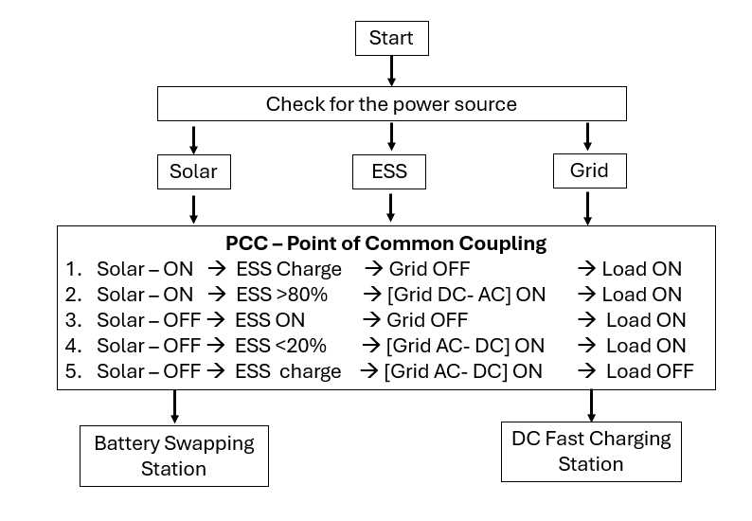
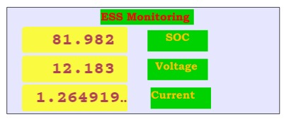

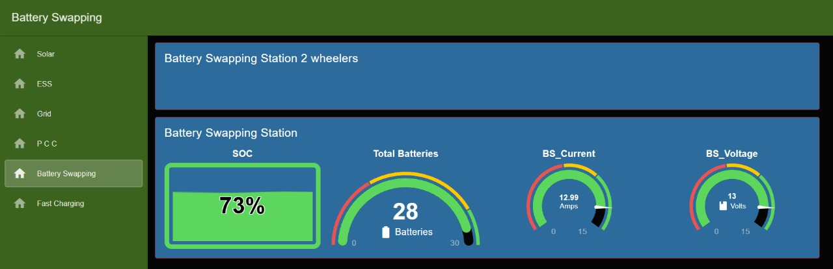
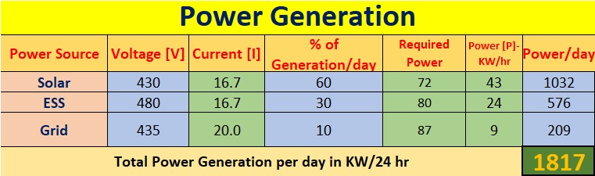
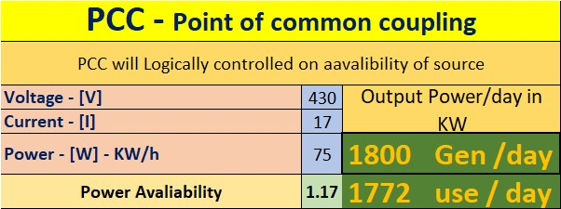
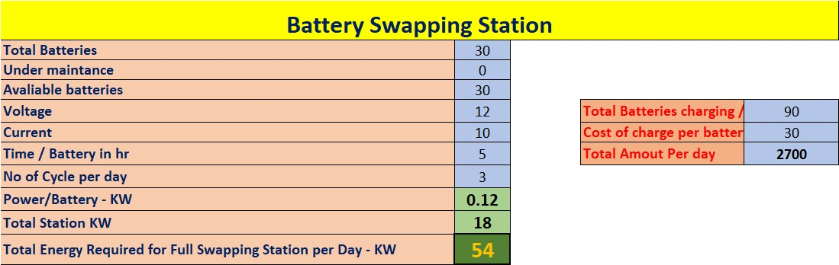
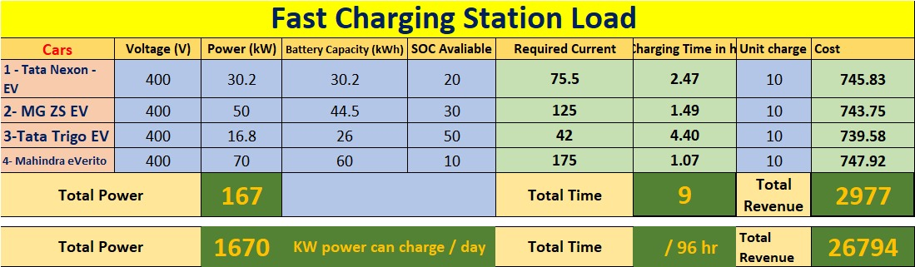
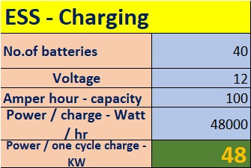
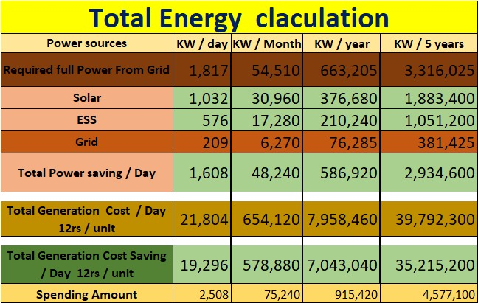
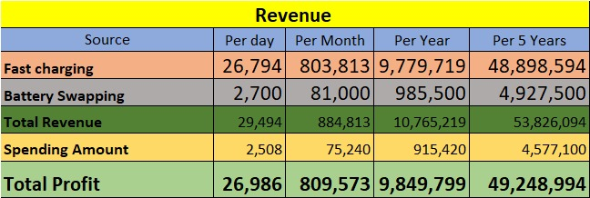




Design of IOT Architecture for Battery Charging Management System
1st Edition of ECE Open Day
School of Engineering and Sciences
Department of Electronics and Communications Engineering,
M. Tech Project 2023-2025
Dr. Sujith Kalluri^{1,} Jagadeeswara Chandra bose.k ¹, Jaswanth Kumar ² , Uttam Kumar ²,
¹Department of ECE, SRM University AP
Abstract
Methodology
Simulation work
Rapid growing of electric vehicle (EV) adoption faces challenges such as range anxiety and inconsistent charging infrastructure, which can be effectively addressed through an IoT-based architecture that offers real-time monitoring, predictive analytics, and mobile charging units, ultimately enhancing user experience, optimizing energy management, and promoting sustainable energy solutions for a cleaner future.
IoT Five-Layered Architecture
User Interface Application Layer
Cloud Server and Data Storage
Communication Layer
Microcontroller Layer
Sensor Layer.
Introduction
Growing Demand for Charging Infrastructure:
The rapid increase in electric vehicle (EV) sales is creating a pressing need for more efficient and accessible charging stations to alleviate range anxiety among users.
Integration of Renewable Energy:
There is a critical requirement for sustainable charging solutions that incorporate renewable energy sources, such as solar power, to align with environmental sustainability goals.
Cost Reduction and Innovation:
The necessity to reduce operational costs in charging management is driving the adoption of innovative IoT technologies aimed at optimizing battery management and enhancing overall efficiency.
Point of Common Coupling (PCC)
Combines solar power, ESS, and grid power for Integration and Automation.
Real Time Monitoring
Problem Statement
Data Visualization
Demand of Charging Infrastructure Expansion
Grid Load Disturbances
High Installation and Operational Costs
Inefficient Load Management
Limited Remote Monitoring
Algorithms
MPPT (Maximum Power Point Tracking) Algorithm:
Optimizes solar panel output by continuously adjusting the operating point to maximize energy capture under varying conditions.
Battery Swapping Station Algorithm:
Manages logistics and scheduling for battery swaps, optimizing inventory and availability of charged batteries to improve service efficiency.
Vehicle Charging Control Calculation:
Calculates optimal charging rates based on battery state-of-charge (SOC) and user demand, ensuring safe and efficient charging.
Safety and Blast Condition Prediction using ML:
Utilizes machine learning models to analyze historical data and predict potential safety hazards in battery charging environments, enabling proactive risk management.
Estimated Energy and Cost calculation
Objectives
Develop an IoT-based architecture for optimized battery charging management.
Incorporate real-time data monitoring and predictive analytics.
Enhance operational cost efficiency by up to 88.5%.
Promote sustainable energy integration through solar and ESS.
Table 1. Label in 24pt Calibri.
Project Novelty
Innovative IOT 5 layered Architecture.
Integration of multiple energy sources.
Central monitoring and controlling.
Real-Time data processing and user interface.
Cloud connectivity.
Cost efficiency model.
Scalability and Adaptability.
Portable charging station.
Conclusion
The proposed IoT-based architecture addresses critical challenges in EV charging infrastructure by enhancing efficiency, integrating renewable energy, and providing real-time monitoring.
This innovation paves the way for sustainable transportation and significant cost savings.
Contact
References
Jagadeeswara Chandra bose.k
SRM University AP
Email: Jagadeeswara_kamarajugadda@srmap.edu.in
Phone: +91 9705233003
Cheng-Ta Chiang; Liang-Yu Chien “A Pitaya Dye-Sensitized Solar Cell Monitor for Environmental Sunlight Intensity Detection” IEEE Sensors Journal, 19-11, 03 February 2019.
Saswat Kumar Ram; Sauvagya Ranjan Sahoo; Banee Bandana Das; Kamalakanta Mahapatra; Saraju P. Mohanty “Eternal-Thing: A Secure Aging-Aware Solar-Energy Harvester Thing for Sustainable IoT” IEEE Transactions on Sustainable Computing, 6-2, 15 April 2020.
Tai-Yeon Ku; Wan-Ki Park; Hoon Choi “ESS Simulation based on PV Generation Prediction” 2018 International Conference on Information and Communication Technology Convergence (ICTC), 18 November 2018.
Abdelrahman Ahmed; Sobhy Abdelkader; Ehab Ayman “IoT-based optimization of microgrid operation” 2023 24th International Middle East Power System Conference (MEPCON), 18 March 2024.
George Y. Odongo; Richard Musabe; Damien Hanyurwimfura; Abubakar Diwani Bakari “An Efficient LoRa-Enabled Smart Fault Detection and Monitoring Platform for the Power Distribution System Using Self-Powered IoT Devices” IEEE Access (Volume: 10), 07 July 2022.
Isa Hafidz; Ardyono Priyadi; Margo Pujiantara; Dimas Okky Anggriawan; Mauridhi Hery Purnomo “Development of IoT-Based Portable Power Quality Monitoring on Microgrids by Enhancing Protection Features” IEEE Access (Volume: 11), 15 May 2023.
Dan Zheng; Fushuan Wen; Jiansheng Huang “Optimal planning of battery swap stations” International Conference on Sustainable Power Generation and Supply (SUPERGEN 2012), 04 April 2013.
Bansilal Bairwa; Mrinal Sarvagya; Sanjeeva Kumar; Arpita Banik “Battery Swapping Mobile Service Station for Electric Vehicles Application” 2021 Second International Conference on Smart Technologies in Computing, Electrical and Electronics (ICSTCEE), 15 February 2022.
Xian Zhang; Guibin Wang “Optimal dispatch of electric vehicle batteries between battery swapping stations and charging stations” 2016 IEEE Power and Energy Society General Meeting (PESGM), 14 November 2016.
Sayantika Sikdar; Madhavi Damle “IoT Solutions for Electric Vehicles

